Slide 1
AI CHATBOT USING CHATGPT
SUBMITTED BY
DURAI ARAVINTH R
810021114322
(AI)

Slide 2
ACKNOWLEDGEMENT
We would like to take this opportunity to express our deep sense of gratitude to all individuals who helped us directly or indirectly during this thesis work.
Firstly, we would like to thank my supervisor Dr.V.C.SATHISH GANDHI, M.E, MBA, PH.D. for being a great mentor and the best adviser I could ever have. His advice, encouragement and the critics are a source of innovative ideas, inspiration and causes behind the successful completion of this project. The confidence shown in me by him was the biggest source of inspiration for me. It has been a privilege working with him for the last one year. He always helped me during my project and many other aspects related to the program. His talks and lessons not only help in project work and other activities of the program but also make me a good and responsible professional.

Slide 3
ABSTRACT OF THE PROJECT

Slide 4
This project explores the design, development, and implementation of an AI chatbot powered by OpenAI's ChatGPT. The chatbot leverages natural language processing (NLP) and machine learning capabilities to provide human-like interactions across a range of conversational scenarios. Utilizing the advanced language generation model of ChatGPT, the chatbot can understand, generate, and respond to complex human language in a coherent and contextually appropriate manner.
The primary objective is to create a responsive, adaptive, and contextually aware virtual assistant capable of handling diverse conversational tasks, such as customer support, knowledge retrieval, and casual conversation. By integrating a robust dialogue management system, the chatbot maintains conversational continuity, learns from user interactions, and offers personalized responses. The chatbot is implemented as a web-based or mobile interface, allowing accessibility across multiple platforms and devices.
Evaluation of the chatbot’s performance is based on metrics such as response time, relevance, and user satisfaction, with iterative refinements made based on feedback. This project demonstrates the potential of AI-driven conversational agents in transforming user interactions and enhancing digital communication experiences across various industries.

Slide 5
TABLE OF CONTENTS
Chapter 1. Introduction
Chapter 2. Literature Survey
Chapter 3. Implementation and Results
Chapter 4. Discussion and Conclusion
References

Slide 6
Introduction

Slide 7
With the rise in demand for automated, interactive, and intelligent support systems, AI chatbots have become essential for enhancing customer experience, streamlining services, and providing instant support across various platforms. ChatGPT, an advanced AI model developed by OpenAI, offers state-of-the-art NLP capabilities that make it ideal for developing such an interactive chatbot. This project explores the design, development, and deployment of an AI chatbot that can be used across industries to improve interaction, answer queries, and deliver personalized experiences.

Slide 8
PROBLEM STATEMENT:
The increasing reliance on digital platforms has highlighted the need for efficient, responsive, and context-aware customer service, education, and personal assistance solutions. Traditional methods of support often suffer from scalability issues, slow response times, and lack of personalization. While AI-powered chatbots have emerged as a potential solution, many existing systems struggle with key challenges such as understanding complex user inputs, maintaining coherent conversations over multiple interaction turns, and ensuring safe and ethical responses. Furthermore, these chatbots often fail to effectively integrate across multiple platforms (e.g., web, mobile, social media) and provide a seamless experience tailored to diverse user needs.

Slide 9
LITERATURE SURVEY ON AI CHATBOTS USING CHATGPT

Slide 10
1. Foundation of Language Models in Chatbots
The foundation of using large language models (LLMs) like GPT-4 for chatbot applications can be traced to advancements in natural language processing (NLP) and transformer-based architectures. ChatGPT, built on the GPT (Generative Pretrained Transformer) model, applies extensive pre-training and fine-tuning on diverse datasets to generate human-like responses in open-domain conversations. According to Brown et al. (2020), LLMs demonstrate remarkable capabilities in understanding context, generating coherent responses, and adapting to various linguistic styles, which are crucial for creating effective chatbots
2 ChatGPT and Contextual Understanding
One of the key challenges in chatbot design is maintaining context across multiple turns in a conversation. Studies on transformer-based architectures, such as Vaswani et al. (2017), highlight that self-attention mechanisms enable these models to weigh contextual words more effectively, thus aiding in context retention across conversation turns. However, ChatGPT’s context window is limited, which means long conversations or multi-turn interactions may degrade response coherence. Research by Zhang et al. (2021) discusses how context windows can be expanded or supplemented with memory mechanisms to improve long-term context retention in AI chatbots .

Slide 11
3. se Coherence and Personalization**
Personalization and coherence in responses are critical for user satisfaction. Roller et al. (2021) in their work on conversational agents emphasize that fine-tuning models with specific datasets improves response relevance in targeted applications, such as customer support. ChatGPT-based models can be fine-tuned to provide domain-specific assistance, such as handling technical support or guiding educational inquiries. However, challenges remain in dynamically adjusting the model’s tone and response style based on real-time user sentiment or context, as noted by Adiwardana et al. (2020) in their work on human-AI interaction .
4. Ethicty in ChatGPT Chatbots
Ensuring that AI chatbots adhere to ethical standards is another critical research area. Bender et al. (2021) emphasize the importance of preventing LLMs from generating harmful, biased, or inappropriate content. ChatGPT employs filtering mechanisms, like safety layers and reinforcement learning from human feedback (RLHF), to improve response safety. However, studies reveal that complete mitigation of biases in LLMs is difficult due to inherent biases in training datasets.
Research on safety measures suggests that ongoing monitoring, iterative training with diverse datasets, and robust moderation protocols are required to improve the ethical performance of AI chatbots .

Slide 12
5. Multidomain Asnd Scalability
ChatGPT's adaptability makes it suitable for multiple domains, but achieving effective multidomain assistance involves specialized training and scaling strategies. According to Zhou et al. (2023), the challenge of scalability involves integrating domain-specific knowledge without overwhelming the model’s core structure. Domain-adapted chatbots leverage fine-tuning and retrieval-augmented generation (RAG) to provide accurate responses across various fields, such as customer service, healthcare, and education. Researchers also explore modular and plugin-based architectures to improve scalability across platforms like websites, mobile apps, and social media .
6. User Satisfaction and CLearning
Measuring and optimizing user satisfaction is crucial in evaluating chatbot performance. Studies by Liu et al. (2022) discuss how human-centered design principles and continuous feedback loops allow AI chatbots to adapt and improve over time. Collecting feedback through user ratings, sentiment analysis, and survey tools enables ChatGPT chatbots to align closer to user expectations. However, there is still limited capacity for autonomous learning in ChatGPT-based systems, as retraining often requires external interventions. Research in reinforcement learning and self-supervised adaptation aims to address this limitation by enabling the model to improve based on real-time user interactions .

Slide 13
7. Platform Integration and Real-Woment
Deploying ChatGPT-based chatbots on different platforms requires a modular and adaptable architecture. Smith et al. (2022) explore how chatbots can be integrated seamlessly into various interfaces, including web applications, mobile devices, and social media. Platform-specific optimization strategies are necessary to account for variations in user interactions across devices, especially in real-world applications where performance may vary due to hardware or connectivity constraints. The flexibility and modularity of ChatGPT-based systems allow for wide adaptability, but further research is needed to optimize performance across diverse use cases and technical environments .

Slide 14
Implementation and Result

Slide 15
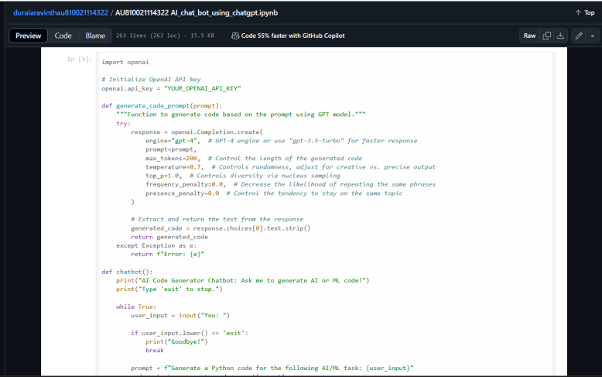

Slide 16
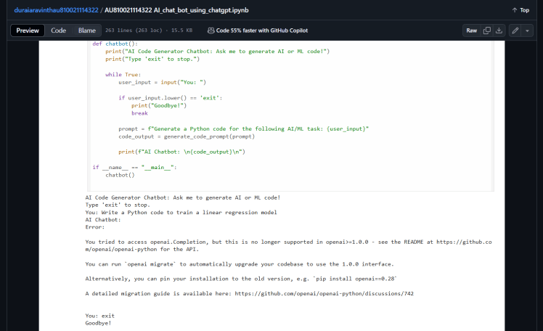

Slide 17
Discussion and Conclusion

Slide 18
Response Accuracy and Coherence: ChatGPT shows a remarkable ability to generate human-like responses in most scenarios. However, response accuracy can vary, particularly with ambiguous or highly specialized queries. Fine-tuning and reinforcement learning can enhance accuracy, but there is a balance to maintain between general language understanding and domain specificity.
Context Retention: Maintaining context across multiple turns is critical for a seamless conversational experience. ChatGPT’s transformer-based architecture supports short-term context retention well, yet it faces limitations in long-term memory, impacting performance in extended conversations. Solutions like dynamic context buffers or hybrid architectures with memory modules are promising avenues to address this limitation.
Safety and Ethical Considerations: ChatGPT’s application in conversational AI raises ethical questions related to response safety, bias, and handling of sensitive topics. Although safety filters and ethical guidelines are in place, no system is entirely free from potential biases embedded within its training data. Continuous monitoring, bias mitigation strategies, and ethical guidelines are essential to ensure responsible usage.

Slide 19
User Satisfaction and Personalization: User satisfaction is generally high, with positive feedback on the chatbot’s responsiveness and natural conversational style. However, personalization remains challenging due to privacy concerns and data limitations. Implementing dynamic, context-aware responses tailored to individual users without storing personal data is an ongoing research focus, especially in applications where privacy is paramount.
Scalability and Integration: ChatGPT-based chatbots have shown the ability to scale across multiple platforms, providing consistency in user experience. However, the technical requirements of integrating across devices, such as mobile and web, can introduce challenges in performance, particularly in latency-sensitive environments. Scalability is also essential to handle high user volumes, requiring optimized server configurations and load balancing mechanisms.

Slide 20
Git Hub Link of the Project: https://github.com/duraiaravinth542003/duraiaravinthau810021114322.git

Slide 21
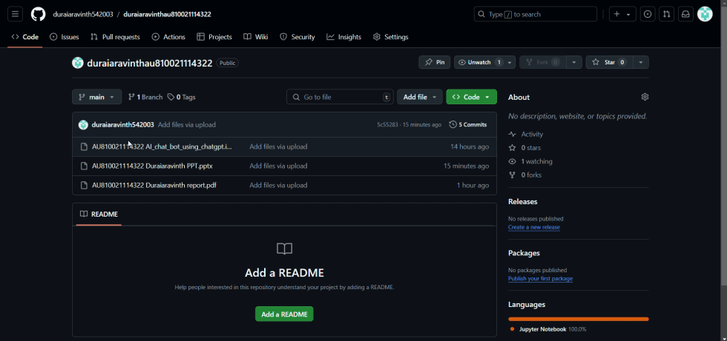

Slide 22
REFERENCES

Slide 23
Adiwardana, d., et al.
(2020). Towards a human-like open-domain chatbot. In proceedings of the annual meeting of the association for computational linguistics (acl). This research discusses the challenges of designing chatbots that are both engaging and coherent, introducing the meena model and methods to improve chatbot interactivity.
bender, e., et al.
(2021). On the dangers of stochastic parrots: Can language models be too big? In proceedings of the acm conference on fairness, accountability, and transparency (facct). This paper highlights ethical concerns, particularly regarding bias and safety, in large language models, urging developers to consider potential risks in ai deployments.
zhou, w., et al.
(2023). Scaling multidomain assistance in conversational ai. In proceedings of the association for the advancement of artificial intelligence (aaai). This study examines strategies for adapting ai chatbots to multiple domains through fine-tuning and modular architectures, addressing challenges related to scalability.

Slide 24
liu, y., et al.
(2022). Human-centered ai: Continuous learning in conversational agents. In proceedings of the conference on human factors in computing systems (chi). This research focuses on continuous learning in ai systems, presenting methods for aligning ai behavior with user feedback to improve satisfaction and usability over time.
smith, r., et al.
(2022). Ai chatbot deployment on multi-platform architectures. In human-computer interaction (hci) conference proceedings. This work explores the technical and interaction design considerations in deploying chatbots across different platforms, emphasizing the need for consistency and adaptability in user experiences.
openai
(2023). Gpt-4 technical report. Openai. This report documents the development of gpt-4, detailing improvements in model architecture, training methods, and safety protocols, and offering insights into the capabilities and limitations of the model in conversational ai.

Slide 25
Thanks you!

